Slide 1
Simulation
Motivation
DA 507
Birol Yüceoğlu
Numerical Simulations
Discrete Event Simulation

Slide 3
Where are we?
 |  | Data
 |  | Known (Approximated) | Unknown (Distribution is known)
Solution Approach | Optimal (analytical) | LP & IP | Markov Chains
 | Good enough (numerical) | Heuristics | Simulation

Slide 4
Simulation
Simulation is the process of designing a model of a system and conducting experiments for
  Understanding the behavior of the systems
  Proposing new strategies and policies for the operation of this system

Slide 5
Why and when to use simulation?
Safe and cheap
  Consider a flight simulator used for training of aircraft pilots.
Analyzing complex systems
  Consider the queues in your bank branches, the assembly line in your factory. You have to make a decision on the number of counters opened during different times of the day.
  Can you use integer/linear programming?
  Only if you know the arrival and processing times of all customers (there is no randomness)
  You need to have a better model to be able to generalize your results
Causes no disruption

Slide 6
Simulation types
Static vs dynamic
  Static models represent a system at a particular time (Monte Carlo)
  Dynamic models represent systems where the state of the variables change over time (simulation of a bank, factory)
Deterministic vs stochastic
  Deterministic models do not contain random variables (Dentist Office where customers arrive on appointed times and service times are known)
  Stochastic models have at least one random variable (Dentist Office where customers arrive on time but the service time is not known apriori)

Slide 7
Simulation types
Continuous vs discrete time
  In discrete time simulation the state of the system changes at a discrete set of points in time, such as customer arrival and departures in the bank example.
  In continuous systems the state change continuously in time, such as weather
    Continuous systems can be simulated using discrete models with higher precisions.

Slide 8
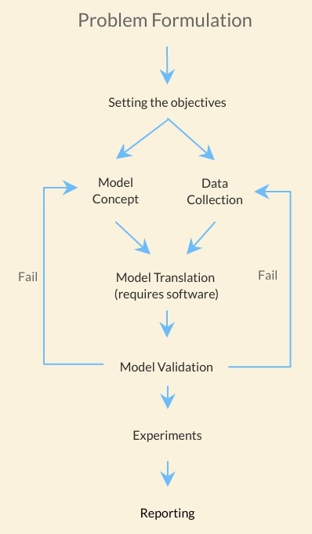
Simulation Approach
Validation step will allow you check that
your simulation (including model and data)
can mimic your real life systems.
In the experiment phase you can try your
policy improvements, such as increasing the
number of counters, changing the assembly
order.

Slide 9
Concepts of Simulation
Entities: Any object or component in the system which requires explicit representation in the model (e.g., a server, a customer, a machine).
  Attributes: The properties of a given entity (e.g., the priority of a waiting customer, the routing of a job through a job shop).
System: A collection of entities (e.g., people and machines) that interact together over time to accomplish one or more goals.
Model: An abstract representation of a system, which describe a system in terms of state, entities and their attributes, sets, processes, events, activities, and delays.
System state: A collection of variables that contain all the information necessary to describe the system at any time (e.g. The number of people waiting, the state of your resources, i.e. İdle or busy) .

Slide 10
Concepts of Simulation
Event: An instantaneous occurrence that changes the state of a system (such as an arrival of a new customer).
Activity: A duration of time of specified length (e.g., a service time or interarrival time), which is known when it begins (although it may be defined in terms of a statistical distribution).
Delay: A duration of time of unspecified indefinite length, which is not known until it ends (e.g., a customer’s delay in a last-in, first-out waiting line which, when it begins, depends on future arrivals).
Event list: A list of event notices for future events, ordered by time of occurrence; also known as the future event list (FEL).
List (Set, Queue): A collection of associated entities, ordered in some logical fashion (such as all customers currently in a waiting line, ordered by first come, first served, or by priority).

Slide 11
Concepts of Simulation
Bank teller example
  System: Bank branch (customers and counters)
  Entities: Customers (having priority attribute)
  System state: The number of people waiting in line, the state of the counters (busy or idle)
  Event: Arrival, departure of customers
  Delay: Waiting time in queue

Slide 12
Example
Customer n
Arrival
Departure
Service begins
Busy
Customer n + 1
Arrival
Service begins
Departure
Idle
Server status

Slide 13
Advanced Concepts (Preemption)
Preemption
Customer n
Arrival
Departure
Service begins
Service begins
Busy
Customer n + 1
Departure
Arrival &
Service
Server status
Idle

Slide 14
Advanced Concepts (Priority)
New arrival

Slide 15
Advanced Concepts (Reneging / Baulking)

